Slide 1
Privacy Milestone 5: Trade-offs and Interactions with other verticals in Trustworthy AI
Roseline Polle
Postgraduate, UCL
roseline.polle.19@ucl.ac.uk
Notes:
Assessing and Mitigating Bias and Discrimination in AI
Part I: Ethical, Legal, and Governance aspects of AI Bias and Discrimination
Part II: Technical dimensions of Bias and Discrimination in Supervised Machine Learning

Slide 2
1. Privacy in Machine Learning

Slide 3
Protect the data
Algorithms must guarantee data protection throughout a system’s entire lifecycle, whether this is user information provided by the user or generated by the system.
European Commission, Ethics guidelines for trustworthy AI

Slide 4
Type of ML attacks
Integrity: Misclassifications that do not compromise normal system operation (evasion, poisoning,…)
Availability: Misclassifications that compromise normal system operation (poisoning)
Privacy/Confidentiality: infer information about user data and models.
Biggio, Battista, and Fabio Roli. "Wild patterns: Ten years after the rise of adversarial machine learning."
Notes:
Biggio, Battista, and Fabio Roli. "Wild patterns: Ten years after the rise of adversarial machine learning." Pattern Recognition 84 (2018): 317-331.
Rigaki, Maria, and Sebastian Garcia. "A survey of privacy attacks in machine learning." arXiv preprint arXiv:2007.07646 (2020).

Slide 5
System’s lifecycle
ADVERSARIAL KNOWLEDGE
PRIVACY THREATS
DEFENSES
Training data
Access control
Minimisation (GDPR)
Anonymisation
Cryptography
Synthetic data
Leaks
Re-identification
White box
Model & parameters
Reconstruction attacks
(attribute inference, model inversion)
Property Inference
Loss gradients
Model input/output
Membership Inference
Model extraction
Differential Privacy
Detect suspect queries
Black box

Slide 6

Attacker access
Data
Access control
Hardware/Software security
Cryptography
Data
Synthetic data
Data minimisation (GDPR)
Anonymisation
Data
Model

Slide 7
Anonymisation of data

Slide 8
Type of data points
Personally Identifiable Information (PII): name, social security number,…
Quasi-identifiers (QI): age, gender,..
Sensitive attributes: disease,salary,..

Slide 9
k-anonymity, l-diversity and t-closeness
At least k-record with the same identifiable Qis
If all the same sensitive attribute, still insufficient → l-diversity
t-closeness: same but difference of sensitive attribute in equivalence class is similar as in the whole data

Slide 10
Illustration
k-anonymity
l-diversity
t-closeness
Name | Zip | Salary | Salary | Salary
Aaron | 56*** | 20k | 20K | 20K
Bette | 56*** | 20K | 25K | 50K
Charlie | 56*** | 20K | 15K | 30K
Dwayne | 78*** | 50K | 55K | 40K
Elaine | 78*** | 50K | 50K | 60K
Farah | 78*** | 50K | 60K | 15K
Equivalence class 1
Equivalence class 2

Slide 11
Anonymisation is not enough!
Even when the data is not shared, the trained model and user interaction with it can reveal sensitive information

Slide 12
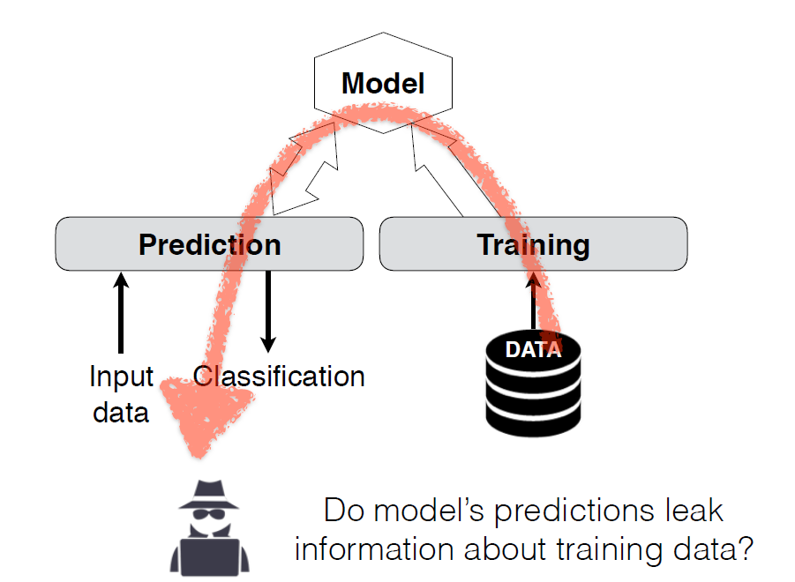
Typical black-box setting
Shokri et al., presentation at 2017 IEEE Symposium on Security and Privacy

Slide 13
Privacy attacks on ML models

Slide 14
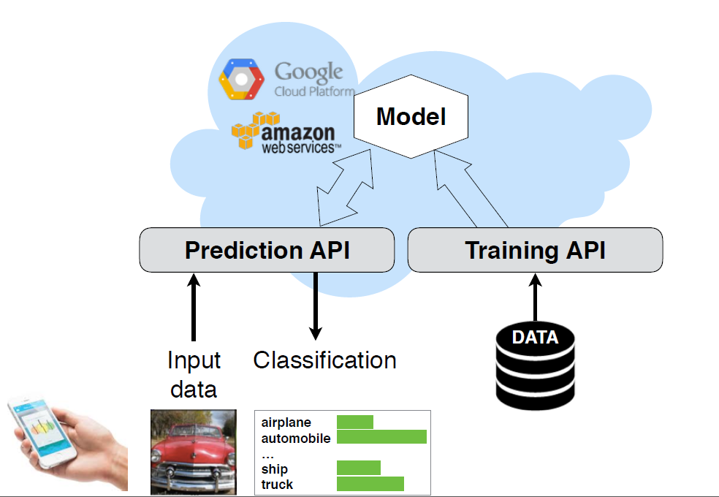
ML-as-a-service (MLaaS)
Shokri et al., presentation at 2017 IEEE Symposium on Security and Privacy
Black box
Notes:
https://www.youtube.com/watch?v=rDm1n2gceJY&t=118s&ab_channel=IEEESymposiumonSecurityandPrivacy

Slide 15
Attacks
[Rigaki & Garcia, 2021]
Membership inference:
Is this sample part of the training data?
Model Extraction Attacks: Can we reproduce the model
Training Data
Model
Members of the population
Property inference: Can we infer some global property of training data that were not intended to share?
Reconstruction attacks:
Model inversion/attribute inference
Can we infer some attributes from the training data?

Slide 16
Attacks
[Rigaki & Garcia, 2021]
Membership inference:
Is this sample part of the training data?
Training Data
Model
Members of the population

Slide 17
Attacks
[Rigaki & Garcia, 2021]
Training Data
Model
Members of the population
Reconstruction attacks:
Model inversion/attribute inference
Can we infer some attributes from the training data?
Notes:
Membership Inference: most studied

Slide 18
Attacks
[Rigaki & Garcia, 2021]
Training Data
Model
Members of the population
Property inference: Can we infer some global property of training data that were not intended to share?
Notes:
Membership Inference: most studied

Slide 19
Attacks
[Rigaki & Garcia, 2021]
Model Extraction Attacks: Can we reproduce the model
Training Data
Model
Members of the population
Notes:
Membership Inference: most studied

Slide 20
Attacks
[Rigaki & Garcia, 2021]
Membership inference:
Is this sample part of the training data?
Model Extraction Attacks: Can we reproduce the model
Training Data
Model
Members of the population
Property inference: Can we infer some global property of training data that were not intended to share?
Reconstruction attacks:
Model inversion/attribute inference
Can we infer some attributes from the training data?
Notes:
Membership Inference: most studied

Slide 21
System’s lifecycle
[Rigaki & Garcia, 2021]
ADVERSARIAL KNOWLEDGE
PRIVACY THREATS
DEFENSES
Training data
Access control
Minimisation (GDPR)
Anonymisation
Cryptography
Synthetic data
Leaks
Re-identification
White box
Model & parameters
Reconstruction attacks
(attribute inference, model inversion)
Property Inference
Loss gradients
Model input/output
Membership Inference
Model extraction
Differential Privacy
Detect suspect queries
Black box

Slide 22
Differential Privacy
DP if cannot determine whether a particular individual has been used in training.
D
A
M
Query
Differ by 1 record
≈
D’
A’
Add noise
Notes:
Cynthia Dwork and Aaron Roth. 2013. The algorithmic foundations of differential privacy. Foundations and Trends in Theoretical Computer Science 9, 3-4 (2013), 211–487. https://doi.org/10.1561/0400000042

Slide 23
2. Privacy and Fairness

Slide 24
Intuition
Sensitive information: sex, gender, religion, ethnicity, etc.
Highly overlaps with information required to measure/mitigate group fairness
Quasi-Identifiers that could help re-identification attacks

Slide 25
Fairness and Privacy
Adding noise for DP may impact some groups more than others [Pujol et al., 2020]
“fair algorithms tend to memorize data from the under-represented subgroups, while trying to equalize the model’s error across groups” [Chang & Shokri, 2021]
Incompatibility theorem btw DP and fairness
→ trade-offs needed [Agarwal, 2021]

Slide 26
Model transparency
Model can leak information about training data
But model transparency helps with explainability & interpretability, which itself helps with fairness

Slide 27
Further readings
Rigaki and Garcia: A Survey of Privacy Attacks in Machine Learning
https://luminovo.ai/blog-posts/data-privacy-in-machine-learning

